Slide 1
Psychology facts
The wonderful way how we think and behave !!

Slide 2
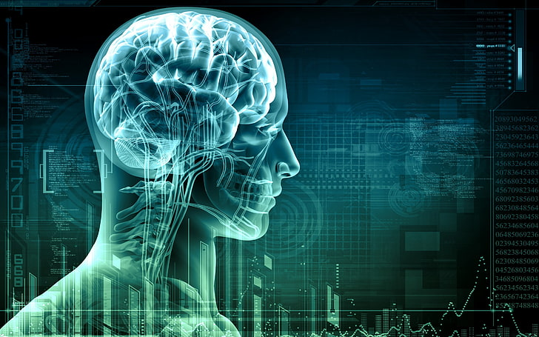
Interesting facts in psychology
The average high school student now has the same level of anxiety as compared to the average psychiatric ward inmate in the early 1950s
People are franker because they’re emotionally drained. That’s why people mention things in late-night talks.
People seem to respect items more when they assemble them on their own, also partially named after the furniture from the renowned store, the ‘IKEA effect.’
France is the most depressed country in the world.

Slide 3
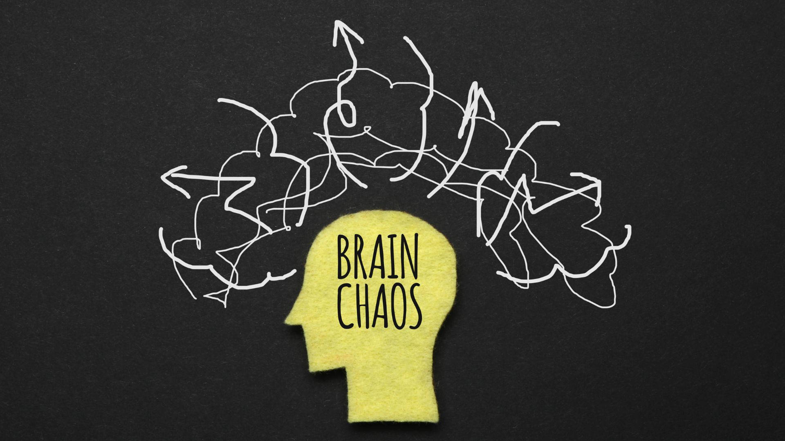
Interesting facts in psychology
It is easier to remember how a story started as well as concluded than its middle
The food you make may not taste as good as the food someone else makes, despite having the same recipe!
The type of music you listen to affects the way you perceive the world.
Convincing yourself you slept well tricks the brain into thinking it did.

Slide 4
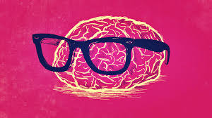
Interesting facts in psychology
Dopamine makes you addicted to seeking information.
We can udnretsnad any msseed up stnecene as lnog as the lsat and frsit lteerts of wdros are in crrcoet palecs. Suhc as tihs stnecene.
Hearing a single negative thing could damage at least five positive memories.
People in blue rooms are also much more productive.
Our minds are working on making boring speeches more exciting.

